Slide 1

Netflix Data- Cleaning, Analysis and Visualization

Slide 2
Presentation Overview
This project involves loading, cleaning, analyzing, and visualizing data from a Netflix dataset. We'll use Python libraries like Pandas, Matplotlib, and Seaborn to work through the project. The goal is to explore the dataset, derive insights, and prepare for potential machine learning tasks.

Slide 3
Objective: Overview and Mission
Import and clean the Data
Analyze Trends and Distributions
Visualizations and Matplotlib and Seaborn
Power BI Dashboard
Extract Key Trends

Slide 4
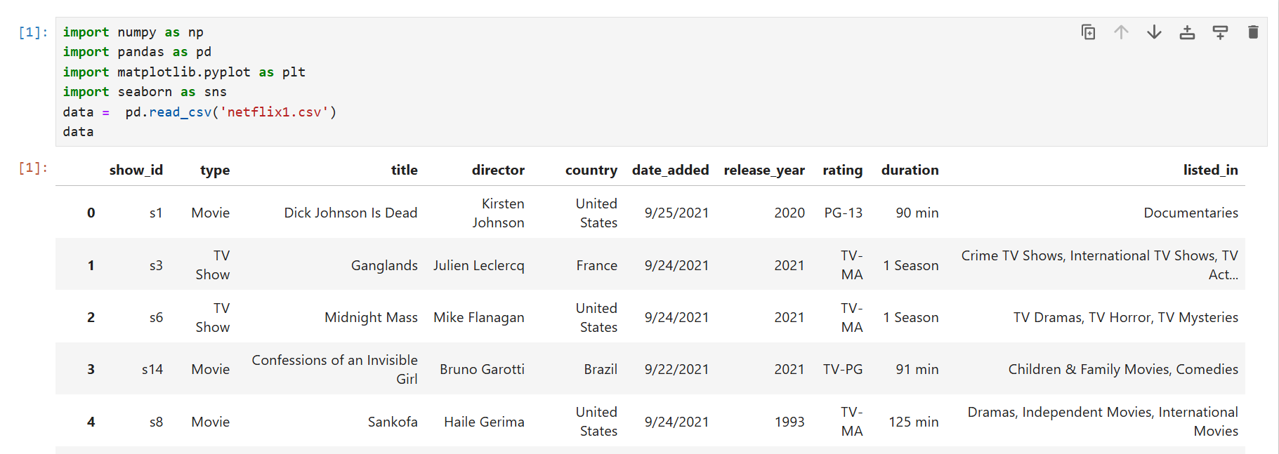
Dataset Overview
Importing Libraries and Modules.

Slide 5
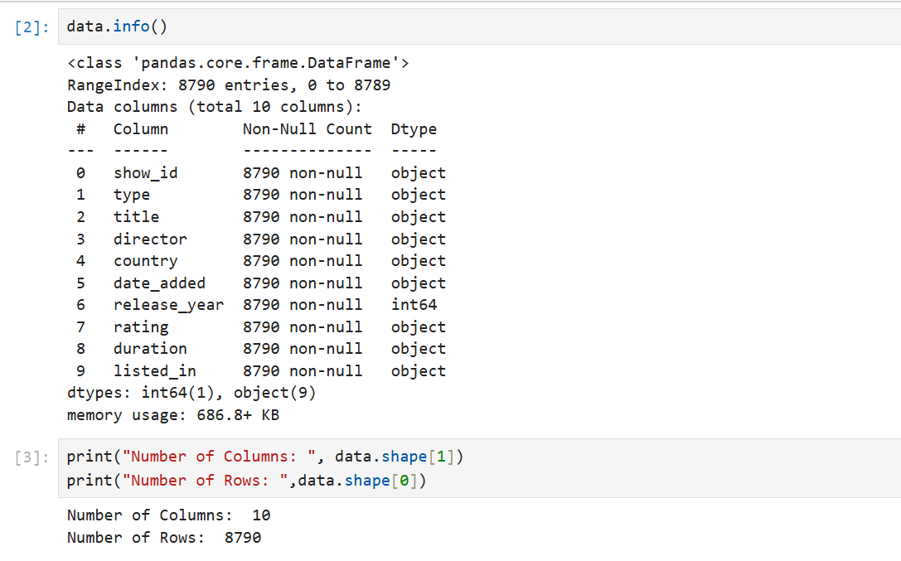
Check the Information

Slide 6
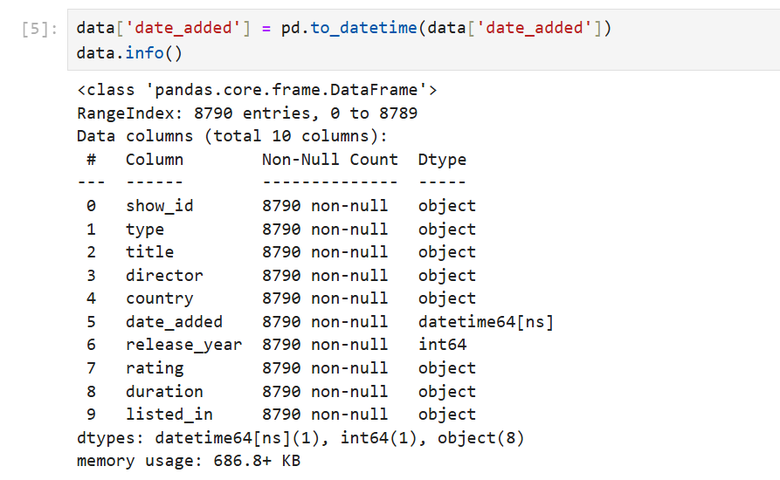
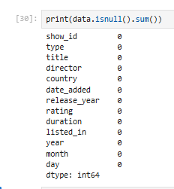
Data Cleaning Process
Handle Null Values

Slide 7

Check Duplicates

Slide 8

Data Visualization Exploratory Data Analysis (EDA)

Slide 9
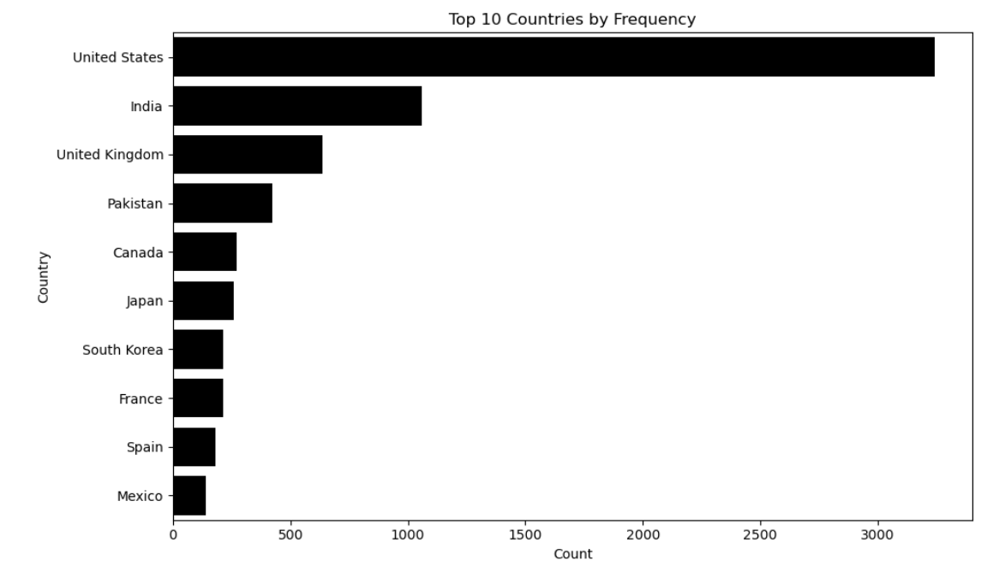
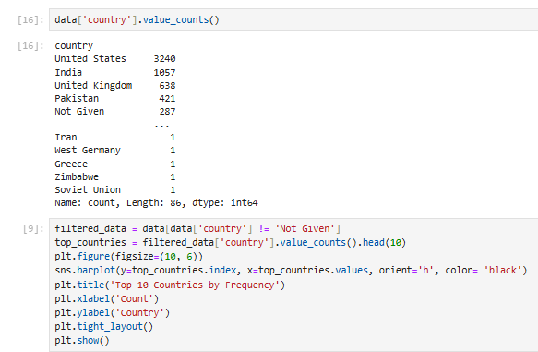
EDA: Country Content Distribution

Slide 10
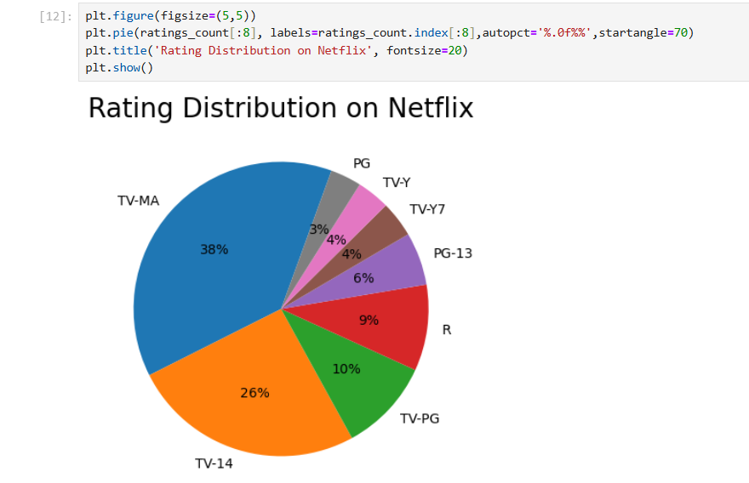
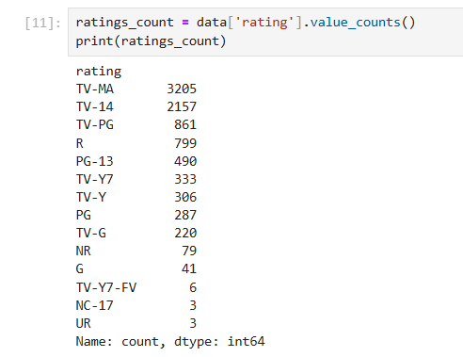
EDA: Ratings Distribution

Slide 11
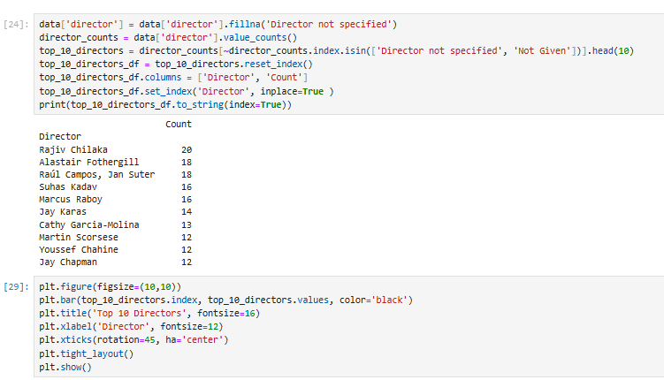
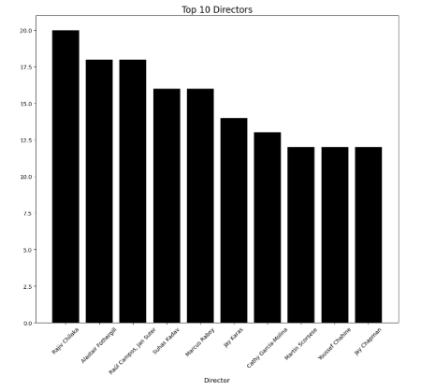
EDA: Director Analysis
**Top 10 Directors Identified:**

Slide 12
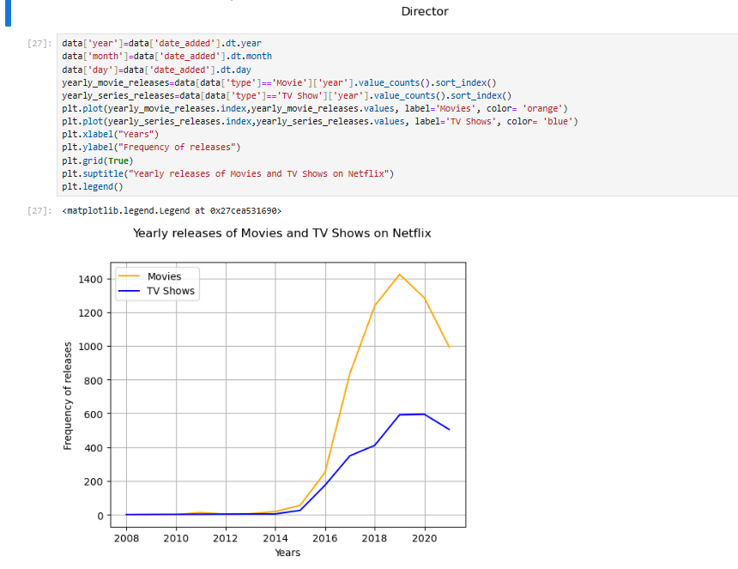
Content Growth: Significant increase in Netflix's content library over the years.

Slide 13
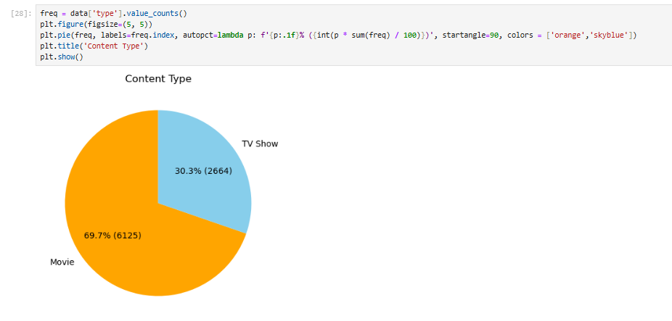
Analysis

Slide 14
Key Insights and Findings
Content Breakdown: Movies (69.7%, 6126 titles) and TV Shows (30.3%, 2664 titles).
Top Genres: International Dramas (362), Documentaries (359), Stand-Up Comedy (334).
Production Trend: Significant growth post-2000.
Top Countries: USA, India, and U K. Popular Directors: RajivChilaka, Alastair Fothergill, Raul Campos, JanSuter.
Leading Content Ratings: TV-MA, followed by TV-14 and TV-PG.

Slide 15
Power BI Dashboard Design for Netflix Analysis

Slide 16
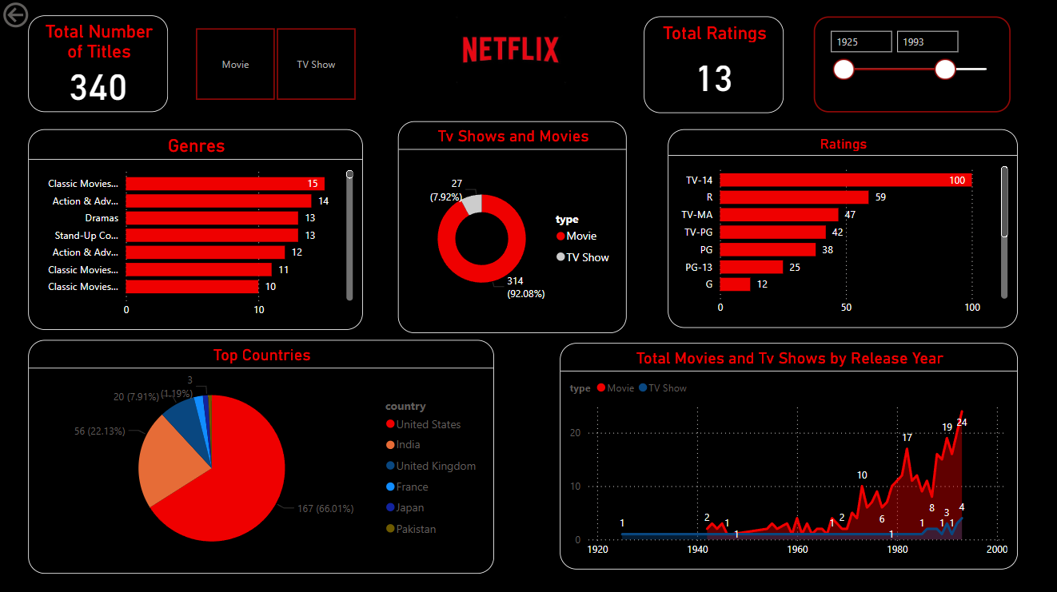

Slide 17
Conclusion from Netflix Dashboard
Conclusion from Netflix Dashboard
Content Distribution: Movies dominate the catalog (92.08%), with TV Shows at 7.92%.
Top Genres: Classic Movies, Action & Adventure, Dramas, and Stand-Up Comedy are the most popular.
Content Ratings: TV-14 is the most common rating, followed by R and TV-MA.
Geographic Insights: The United States leads in content production (66.01%), followed by India and the UK.
Production Trends: Significant growth in content production after 1980, peaking post-2000.
Audience Targeting: The dominance of mature ratings (TV-14, TV-MA) suggests a focus on adult audiences.

Slide 18
Conclusion
This project demonstrates the power of data-driven insights in shaping content strategies, enhancing audience engagement, and driving platform growth. The analysis highlights a significant surge in content production post-2000, reflecting Netflix's strategic global expansion. These insights can guide targeted content investments, cater to diverse audience preferences, and support Netflix's continued leadership in the streaming industry.

